Slide 1
Data Structures
Programming Project #3

Slide 2
Data Center
A data center consists of multiple severs
The servers are connected by switches in a local area network
destination
source

Slide 3
Switches
Each switch has multiple ports
Receive and forward the packets from a port to another port

Slide 4
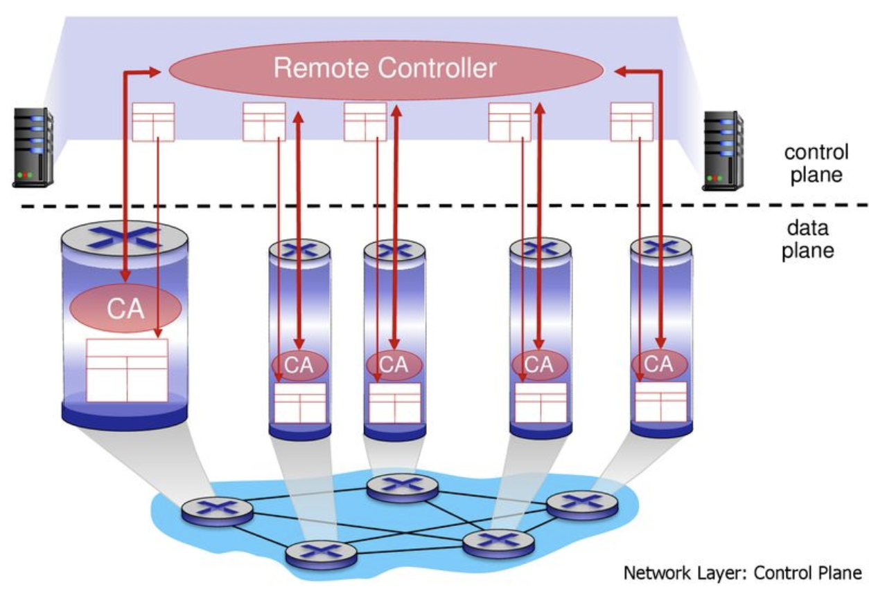
SDN-enabled Switches
A centralized controller is introduced – software-defined networking (SDN)

Slide 5
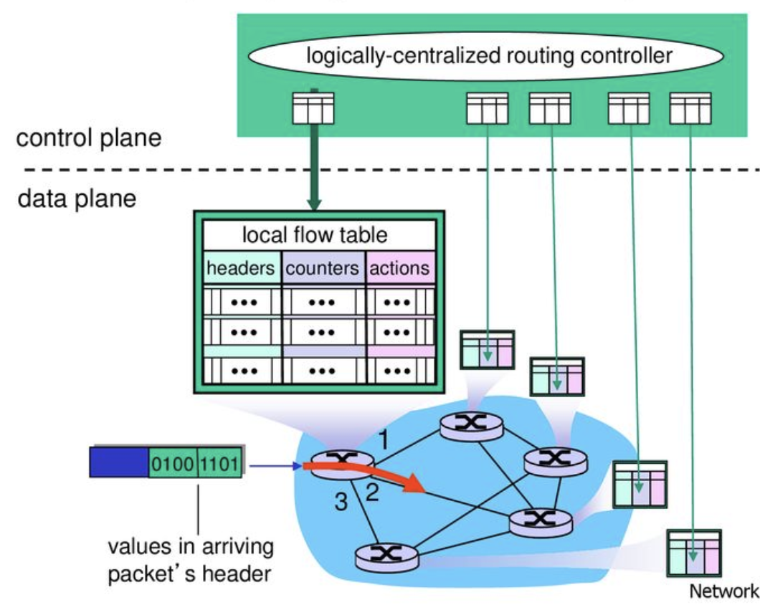
Installing Rules in the SDN-enabled Switches

Slide 6
The Routing Problem
Given the network topology and flow requests
Find a routing path for each flow
Accept the more flows → better
Requests
(src, dest; demand):
(A, F; 1)
(B, E; 1)
(A, F; 2)
1
1
B
G
D
2
1
A
2
1
F
1
3
C
E
3

Slide 7
The Routing Problem
Given the network topology and flow requests
Find a routing path for each flow
Accept the more flows → better
Requests
(src, dest; demand):
(A, F; 1)
(B, E; 1)
(A, F; 2)
1
1
B
G
D
2
1
A
2
1
F
1 (1)
3 (1)
C
E
3 (1)

Slide 8
The Routing Problem
Given the network topology and flow requests
Find a routing path for each flow
Accept the more flows → better
Requests
(src, dest; demand):
(A, F; 1)
(B, E; 1)
(A, F; 2)
1
1
B
G
D
2
1
A
2 (1)
1
F
1 (1)
3 (1)
C
E
3 (2)

Slide 9
The Routing Problem
Given the network topology and flow requests
Find a routing path for each flow
Accept the more flows → better
Requests
(src, dest; demand):
(A, F; 1)
(B, E; 1)
(A, F; 2)
1
1
B
G
D
2
1
A
2 (1)
1
F
1 (1)
3 (1)
C
E
3 (2)
The third flow will be rejected

Slide 10
The Routing Problem
Given the network topology and flow requests
Find a routing path for each flow
Accept the more flows → better
1 (1)
1 (1)
Requests
(src, dest; demand):
(A, F; 1)
(B, E; 1)
(A, F; 2)
B
G
D
2 (2)
1
A
2 (2)
1 (1)
F
1 (1)
3 (3)
C
E
3 (3)

Slide 11
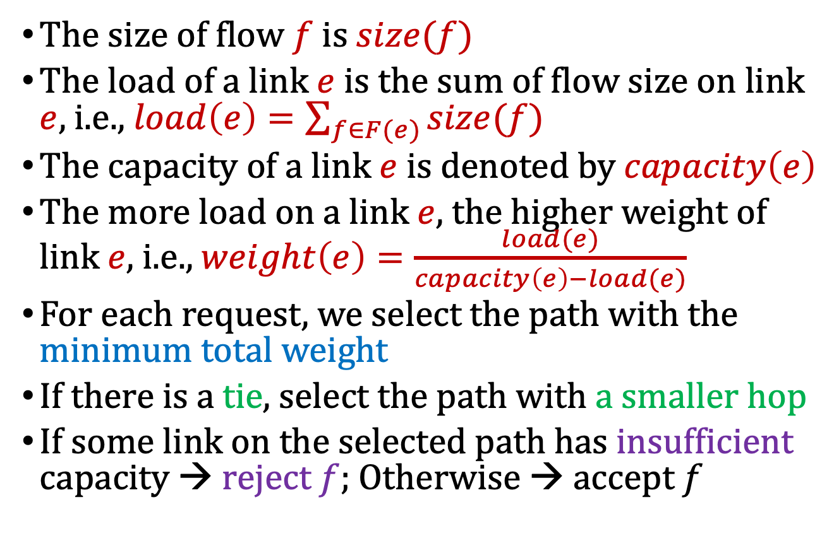
Weighted Links f0r Path Determination
The size of flow $f$ is $size(f)$
The load of a link $e$is the sum of flow size on link $e$, i.e., $load\left(e\right)=\sum_{f∈F(e)}{size(f)}$
The capacity of a link $e$ is denoted by $capacity\left(e\right)$
The more load on a link $e$, the higher weight of link $e$, i.e., $weight\left(e\right)=\frac{load(e)}{capacity\left(e\right)−load(e)}$
For each request, we select the path with the minimum total weight
If there is a tie, select the path with a smaller hop
If some link on the selected path has insufficient capacity → reject $f$; Otherwise → accept $f$

Slide 12
Weighted Links f0r Path Determination
Initially, all links are with weight 0
Choose the one with the smallest hop for the first request
Requests
(src, dest; demand):
(A, F; 1)
(B, E; 1)
(A, F; 2)
1
1
B
G
D
2
1
A
2
1
F
1 (1)
3 (1)
C
E
3 (1)

Slide 13

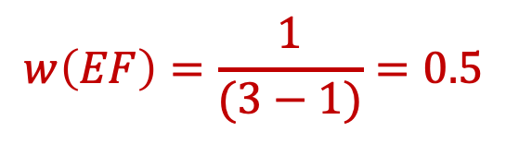
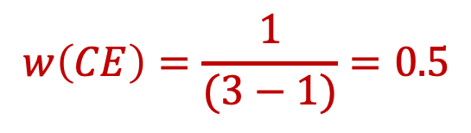
Weighted Links f0r Path Determination
Update the weight of links
$$w\left(CE\right)=\frac{1}{(3−1)}=0.5$$
$$w\left(AC\right)=∞$$
$$w\left(EF\right)=\frac{1}{(3−1)}=0.5$$
Requests
(src, dest; demand):
(A, F; 1)
(B, E; 1)
(A, F; 2)
1
1
B
G
D
2
1
A
2
1
F
1 (1)
3 (1)
C
E
3 (1)

Slide 14
Weighted Links f0r Path Determination
Select the path with the smallest total weight for the second request (i.e., 0)
We do not select the shorter one since its weight = 0.5 > 0
1 (1)
1 (1)
Requests
(src, dest; demand):
(A, F; 1)
(B, E; 1)
(A, F; 2)
B
G
D
2
1
A
2
1 (1)
F
1 (1)
3 (1)
C
E
3 (1)

Slide 15
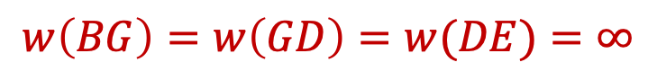
Weighted Links f0r Path Determination
Update the weight of links
$$w\left(BG\right)=w\left(GD\right)=w(DE)=∞$$
1 (1)
1 (1)
Requests
(src, dest; demand):
(A, F; 1)
(B, E; 1)
(A, F; 2)
B
G
D
2
1
A
2
1 (1)
F
1 (1)
3 (1)
C
E
3 (1)

Slide 16
Weighted Links f0r Path Determination
Select the path with the smallest total weight for the third request
1 (1)
1 (1)
Requests
(src, dest; demand):
(A, F; 1)
(B, E; 1)
(A, F; 2)
B
G
D
2 (2)
1
A
2 (2)
1 (1)
F
1 (1)
3 (3)
C
E
3 (3)

Slide 17
The Online Routing Problem
The requests arrive in an online fashion
Accept the more flows → better
Requests
(src, dest; demand):
(A, F; 1)
(B, E; 1)
(A, F; 2)
1
1
B
G
D
2
1
A
2
1
F
1
3
C
E
3

Slide 18
Another Difficulty: TCAM Limit
Every flow uses an entry in the switch on its path
A switch may process more than 10,000 flows
Recall that TCAM size is typically limited to a few thousand entries
1 (1)
1 (1)
Requests
(src, dest; demand):
(A, F; 1)
(B, E; 1)
(A, F; 2)
B
G
D
2 (2)
1
A
2 (2)
1 (1)
F
1 (1)
3 (3)
C
E
3 (3)

Slide 19
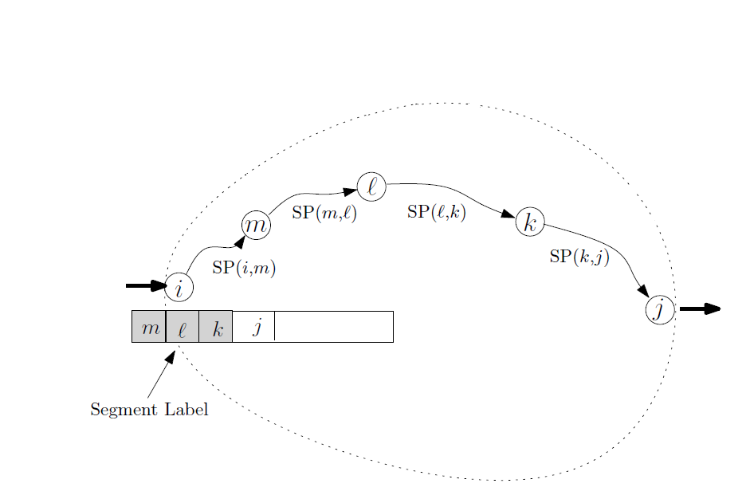
Remedy the Issue: Segment Routing
Idea: break the routing path into segments
Pre-install the segments in the switches
C. Filfils et al., “Segment Routing Architecture,” IETF, Internet Draft, Dec. 2013

Slide 20
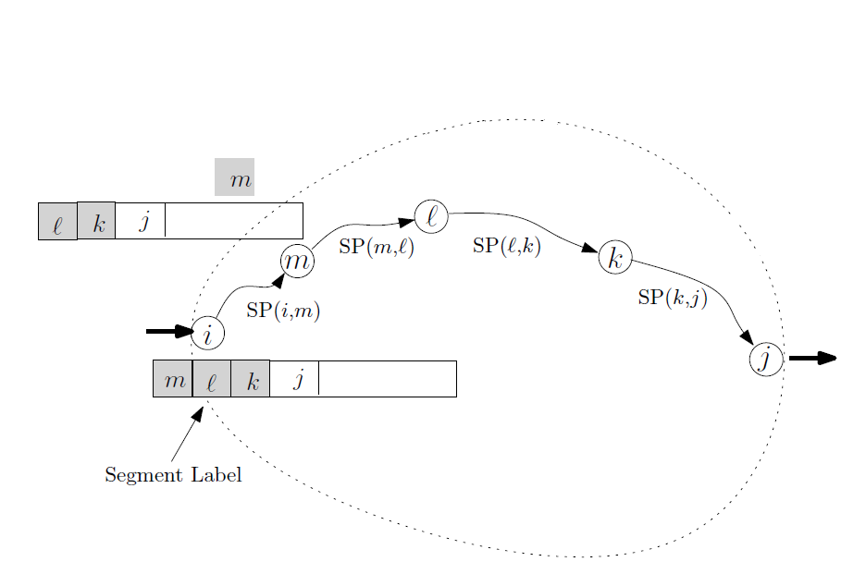
Remedy the Issue: Segment Routing
Idea: break the routing path into segments
Pre-install the segments in the switches
C. Filfils et al., “Segment Routing Architecture,” IETF, Internet Draft, Dec. 2013

Slide 21
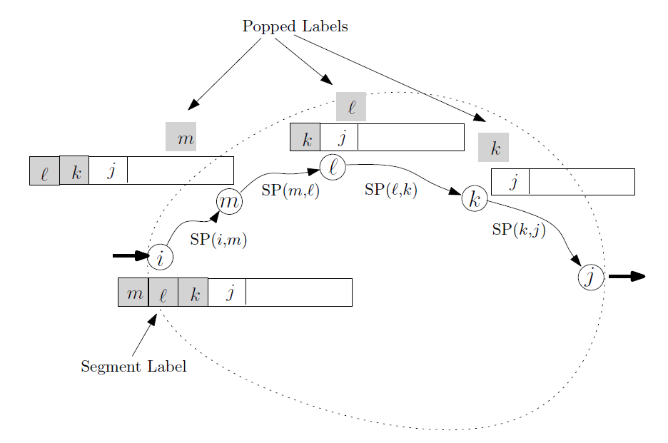
Remedy the Issue: Segment Routing
Idea: break the routing path into segments
Pre-install the segments in the switches
C. Filfils et al., “Segment Routing Architecture,” IETF, Internet Draft, Dec. 2013

Slide 22
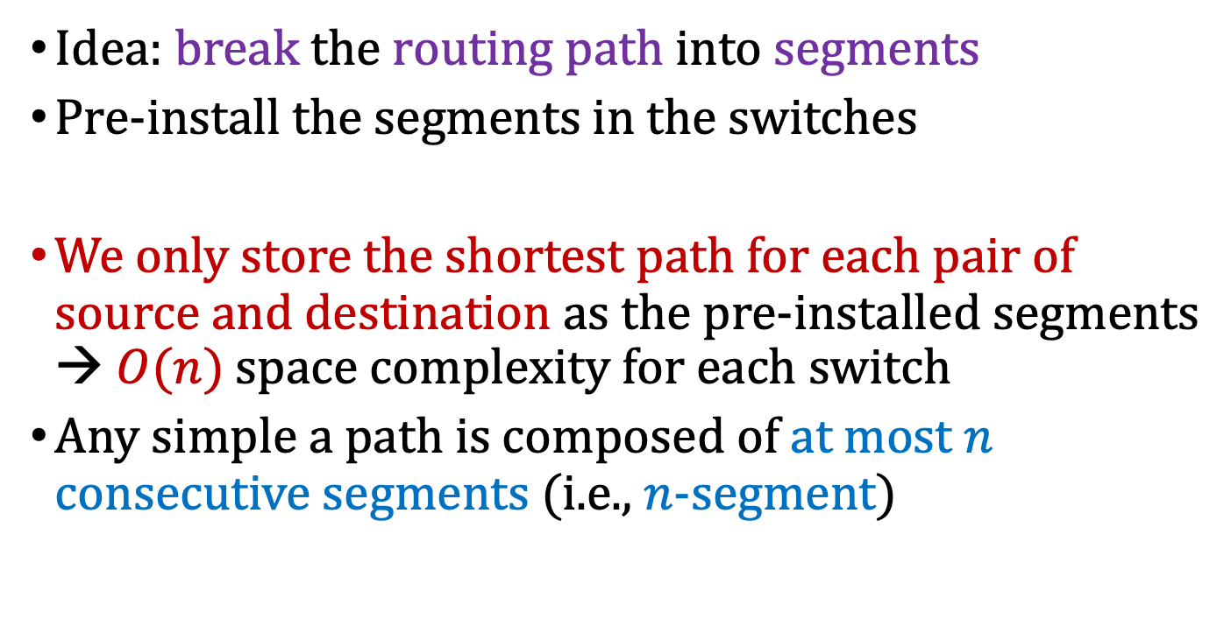
Remedy the Issue: Segment Routing
Idea: break the routing path into segments
Pre-install the segments in the switches
We only store the shortest path for each pair of source and destination as the pre-installed segments → $O(n)$ space complexity for each switch
Any simple a path is composed of at most $n$ consecutive segments (i.e., $n$-segment)
C. Filfils et al., “Segment Routing Architecture,” IETF, Internet Draft, Dec. 2013

Slide 23
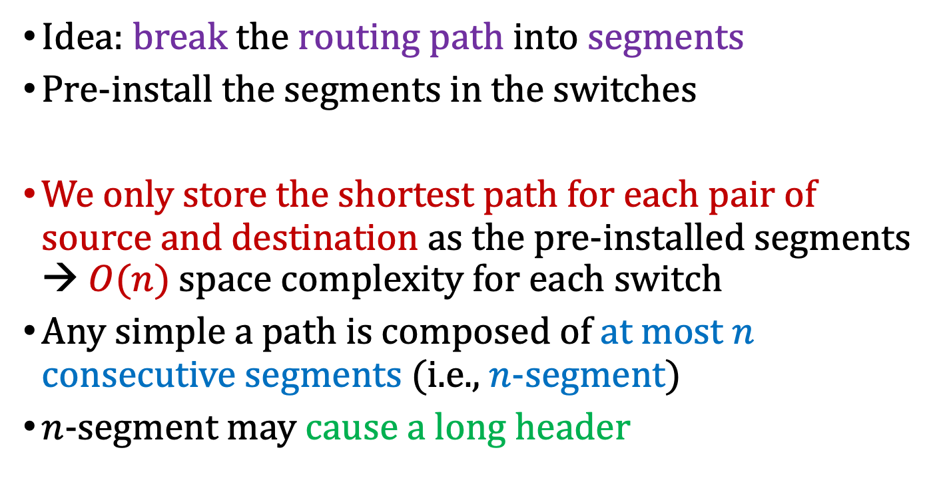
Remedy the Issue: Segment Routing
Idea: break the routing path into segments
Pre-install the segments in the switches
We only store the shortest path for each pair of source and destination as the pre-installed segments → $O(n)$ space complexity for each switch
Any simple a path is composed of at most $n$ consecutive segments (i.e., $n$-segment)
$n$-segment may cause a long header
How about using only 2-segment?
C. Filfils et al., “Segment Routing Architecture,” IETF, Internet Draft, Dec. 2013

Slide 24
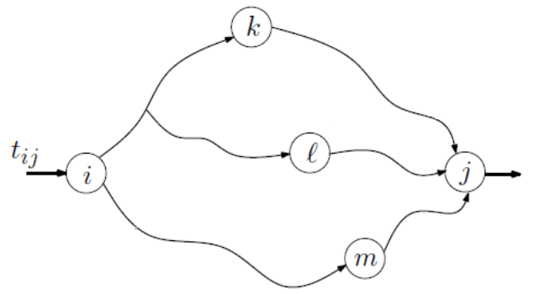
Online 2-Segment Routing
The request arrives over the time
Accept or reject the request at the arrival
Only consider the 2-segement routing path
Select and combine two segments with the smallest total weight
Bhatia et al., “Optimized Network Traffic Engineering using Segment Routing,” in IEEE INFOCOM 2015

Slide 25
Online 2-Segment Routing Problem
The requests arrive in an online fashion
Accept the more flows → better
Every path consists of two segments
Requests
(src, dest; demand):
(A, F; 1)
(B, E; 1)
(A, F; 2)
1
1
B
G
D
2
1
A
2
1
F
1
3
C
E
3

Slide 26
Online 2-Segment Routing Problem
First, compute the all-pair shortest paths
{A}, {A, B}, {A, C}, {A, B, G, D}, {A, C, E}, {A, C, E, F}, {A, B, G},…; Note that {A, C, E, D} is not selected since B’s ID < C’s ID (be carefully!!!)
Requests
(src, dest; demand):
(A, F; 1)
(B, E; 1)
(A, F; 2)
1
1
B
G
D
2
1
A
2
1
F
1
3
C
E
3

Slide 27
Online 2-Segment Routing Problem
Initially, all links are with weight 0
Requests
(src, dest; demand):
(A, F; 1)
(B, E; 1)
(A, F; 2)
1
1
B
G
D
2
1
A
2
1
F
1
3
C
E
3

Slide 28
Online 2-Segment Routing Problem
Examine all 2-segment routing from A to F, i.e., {A}+{A, C, E, F}, {A, B}+{B, C, E, F}, {A, C}+{C, E, F}, {A, B, G, D}+{D, F}, {A, C, E}+{E, F}, {A, C, E, F}+{F}, {A, B, G}+{G, D, F}
Requests
(src, dest; demand):
(A, F; 1)
(B, E; 1)
(A, F; 2)
1
1
B
G
D
2
1
A
2
1
F
1
3
C
E
3

Slide 29
Online 2-Segment Routing Problem
Select path {A}+{A, C, E, F} since it has weight 0 and the smallest number of hops
Requests
(src, dest; demand):
(A, F; 1)
(B, E; 1)
(A, F; 2)
1
1
B
G
D
2
1
A
2
1
F
1 (1)
3 (1)
C
E
3 (1)

Slide 30
Online 2-Segment Routing Problem
Update the weight of links
$$w\left(CE\right)=\frac{1}{(3−1)}=0.5$$
$$w\left(AC\right)=∞$$
$$w\left(EF\right)=\frac{1}{(3−1)}=0.5$$
Requests
(src, dest; demand):
(A, F; 1)
(B, E; 1)
(A, F; 2)
1
1
B
G
D
2
1
A
2
1
F
1 (1)
3 (1)
C
E
3 (1)

Slide 31
Online 2-Segment Routing Problem
Examine all 2-segment routing from B to E, i.e., {B, A}+{A, C, E}, {B}+{B, C, E}, {B, C}+{C, E}, {B, G, D}+{D, E}, {B, C, E}+{E}, {B, C, E, F}+{F, E} {B, G}+{G, D, E}
1 (1)
1 (1)
Requests
(src, dest; demand):
(A, F; 1)
(B, E; 1)
(A, F; 2)
B
G
D
2
1
A
2
1 (1)
F
1 (1)
3 (1)
C
E
3 (1)

Slide 32
Online 2-Segment Routing Problem
Select path {B, G, D}+{D, E} since it has weight 0
1 (1)
1 (1)
Requests
(src, dest; demand):
(A, F; 1)
(B, E; 1)
(A, F; 2)
B
G
D
2
1
A
2
1 (1)
F
1 (1)
3 (1)
C
E
3 (1)

Slide 33
Online 2-Segment Routing Problem
Update the weight of links
$$w\left(BG\right)=w\left(GD\right)=w(DE)=∞$$
1 (1)
1 (1)
Requests
(src, dest; demand):
(A, F; 1)
(B, E; 1)
(A, F; 2)
B
G
D
2
1
A
2
1 (1)
F
1 (1)
3 (1)
C
E
3 (1)

Slide 34
Online 2-Segment Routing Problem
Examine all 2-segment routing from A to F, i.e., {A}+{A, C, E, F}, {A, B}+{B, C, E, F}, {A, C}+{C, E, F}, {A, B, G, D}+{D, F}, {A, C, E}+{E, F}, {A, C, E, F}+{F}, {A, B, G}+{G, D, F}
1 (1)
1 (1)
Requests
(src, dest; demand):
(A, F; 1)
(B, E; 1)
(A, F; 2)
B
G
D
2
1
A
2
1 (1)
F
1 (1)
3 (1)
C
E
3 (1)

Slide 35
Online 2-Segment Routing Problem
Select path {A, B}+{B, C, E, F} since it has the smallest total weight (i.e., 0.5+0.5=1) for the third request
1 (1)
1 (1)
Requests
(src, dest; demand):
(A, F; 1)
(B, E; 1)
(A, F; 2)
B
G
D
2 (2)
1
A
2 (2)
1 (1)
F
1 (1)
3 (3)
C
E
3 (3)

Slide 36
Breaking a Tie All-pair shortest paths
Two shortest path have the same hops → Choose the path with the smaller node ID in sequence
Shortest path from A to D: {A, B, G, D} vs {A, C, E, D} → choose {A, B, G, D}
1
1
B
G
D
2
1
A
2
1
F
1
3
C
E
3

Slide 37
Breaking a Tie Choosing 2-Segment Routing Path
Two 2-segment routing paths have the same total weight → Choose the path with fewer hops
If they still have the same hops → Choose the path with the smaller node ID in sequence
1
H
1
Four 2-segment routing paths from A ->F:
A->B->H->D->F: weight = 0
A->C->G->E->F: weight = 0
A->B->D->F: weight = 100
A->C->H->E: weight = 100
B
D
2
1
Weight = 100
1
A
2
1
F
Weight = 100
1
1
3
C
E
3
G
3

Slide 38
Breaking a Tie Choosing 2-Segment Routing Path
Two 2-segment routing paths have the same total weight → Choose the path with fewer hops
If they still have the same hops → Choose the path with the smaller node ID in sequence
1
H
1
Four 2-segment routing paths from A ->F:
A->B->H->D->F: weight = 0
A->C->G->E->F: weight = 0
A->B->D->F: weight = 100
A->C->H->E: weight = 100
B
D
2
1
Weight = 100
1
A
2
1
F
Weight = 100
1
1
3
C
E
3
G
3

Slide 39
Breaking a Tie Choosing 2-Segment Routing Path
Two 2-segment routing paths have the same total weight → Choose the path with fewer hops
If they still have the same hops → Choose the path with the smaller node ID in sequence
1
H
1
Four 2-segment routing paths from A ->F:
A->B->H->D->F: weight = 0
A->C->G->E->F: weight = 0
A->B->D->F: weight = 100
A->C->H->E: weight = 100
B
D
2
1
Weight = 100
1
A
2
1
F
Weight = 100
1
1
3
C
E
3
G
3

Slide 40
Programming Project #3: Accept or reject a flow with 2-segment routing
Input:
Number of nodes and undirected links
Each link has the non-negative link capacity
Requests with their sources, destinations, and flow size
Procedure:
Accept or reject the flow one by one
If you accept the flow, then assign a path for the flow
Output:
Number of accepted flows
Total throughput
The assigned paths of each accepted flow
Implement the given algorithm to select the flows

Slide 41
Discussion
Maximizing the throughput is NP-hard
You cannot find an efficient algorithm for this problem unless NP = P
There are many heuristic algorithms
“Optimized Network Traffic Engineering using Segment Routing,” in IEEE INFOCOM 2015
“Dynamic Routing for Network Throughput Maximization in Software-Defined Networks,” in INFOCOM 2016
…

Slide 42
Input Sample: input.txt
Format:
#nodes #undirectedLinks
linkID firstNodeID secondNodeID linkCapacity
…
#requestFlows
flowID sourceID destinationID flowSize
…

Slide 43
Input Sample: input.txt
Format:
7 9
0 0 1 2
1 0 2 1
2 1 2 2
3 1 6 1
4 2 4 3
5 3 4 1
6 3 5 1
7 3 6 1
8 4 5 3
3
0 0 5 1
1 1 4 1
2 0 5 2
Requests
(src, dest; demand):
(A, F; 1)
(B, E; 1)
(A, F; 2)

Slide 44
Output Sample: use printf
Format:
3 4
0 0 2 4 5
1 1 6 3 4
2 0 1 2 4 5

